Slide 1
Lecture 10: BA Technologies (Big Data)
Prof. Mike Boyle
Department of Operations and Information Systems
University of Utah

Slide 2
Lecture Outline
Hadoop Overview
Hadoop Distributed File System (HDFS)
Map Reduce
Cluster Configuration

Slide 3
What makes up Hadoop?
When we are refer to Hadoop we mean the core components which are:
Hadoop Distributed File System (HDFS)
Map Reduce
There are also other Hadoop ecosystem projects (i.e. projects related to Hadoop)
Sqoop
Mahout
Pig
Hive
Hbase
Flume
Oozie

Slide 4
Analysis with Hadoop
Organizations turn to the Hadoop and its other ecosystem projects to handle the following tasks:
Text mining/ Sentiment analysis
Graph analysis
Pattern recognition
Collaborative filtering
Predictive analytics
Risk assessment
General data warehousing tasks

Slide 5
Hadoop Distributed File System (HDFS)
File System written in Java
Two Types of Nodes:
Name Node
Data Node (Slave Nodes)
Designed for storing Data on the cluster
Scalable
Fault Tolerant
Supports Map Reduce Process

Slide 6
How HDFS stores information
Data is transferred through various means to the Cluster
Hadoop command line client
Flume
Sqoop
File is broken into blocks of data (64MB each)
Blocks are replicated across data nodes (default is blocks are replicated at 3 nodes)
Name Node holds metadata about files/blocks

Slide 7
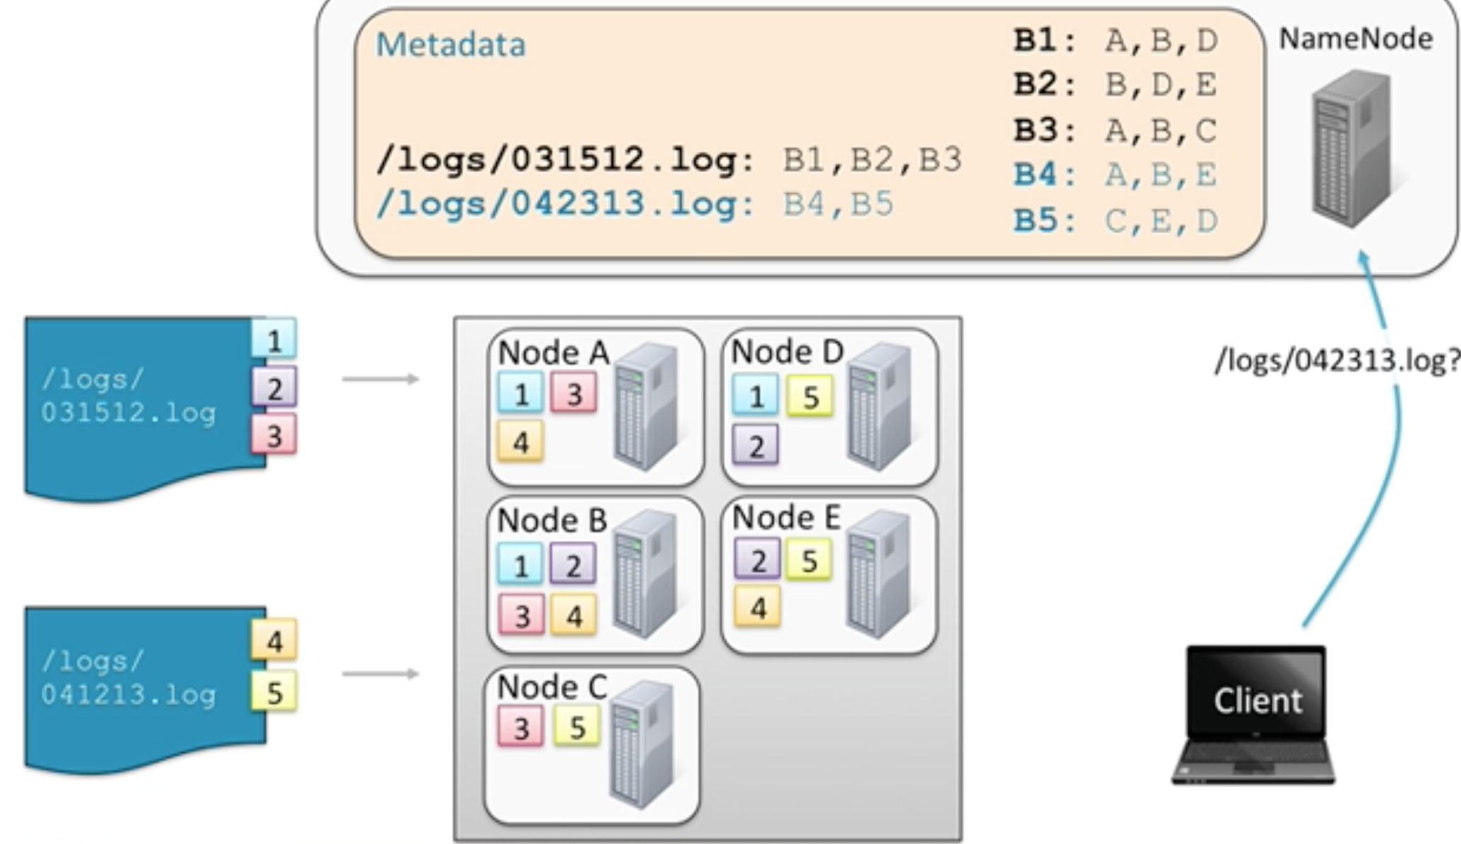
HDFS file storage example
Image source: http://www.cloudera.com/content/cloudera/en/resources/library/training/dissecting-the-apache-hadoop-stack-2-of-6.html, accessed 2014/10/14

Slide 8
HDFS highlights
Optimized for large files
Millions of files, not billions
Optimized for large streaming reads of files
As compared to random access (consider Hbase for random access)
Not set up for editing – write and replace

Slide 9
Node Failure is Inevitable
Hadoop is set up to handle node failure
If a Data node fails:
Master re-assigns work to other nodes
Blocks are replicated over 3 nodes (default setting).
When node recovers, it rejoins cluster automatically
If Master Node Fails:
Standby Master Node is automatically promoted.
When Master node recovers, it is automatically promoted back to the Master Node

Slide 10
Three Phases of Map Reduce
Map
Shuffle and Sort
Reduce

Slide 11
Map
Each task typically operates on 1 block of data
Map task is run on the node where the block of data is stored

Slide 12
Shuffle and Sort
Consolidates all of the data that is produced by the map tasks
Happens after all the map tasks are complete but before the reduce tasks start

Slide 13
Reduce
Utilizes the intermediary data produced in the “Shuffle and Sort phase”
Produces the final output of the process

Slide 14
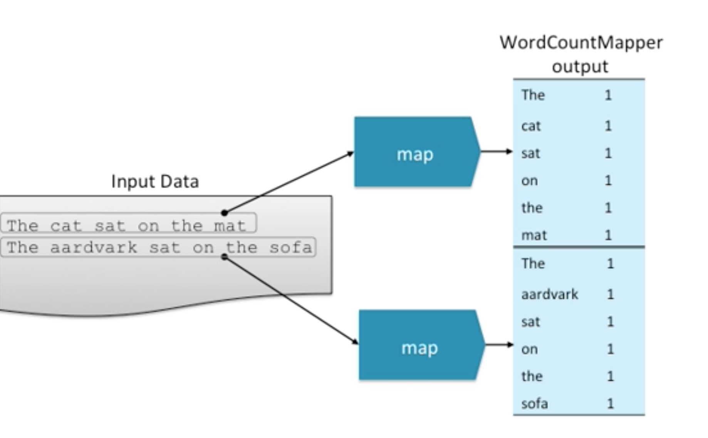
Map Reduce: Word Count [1]
Image source: http://www.cloudera.com/content/cloudera/en/resources/library/training/dissecting-the-apache-hadoop-stack-2-of-6.html, accessed 2014/10/14

Slide 15
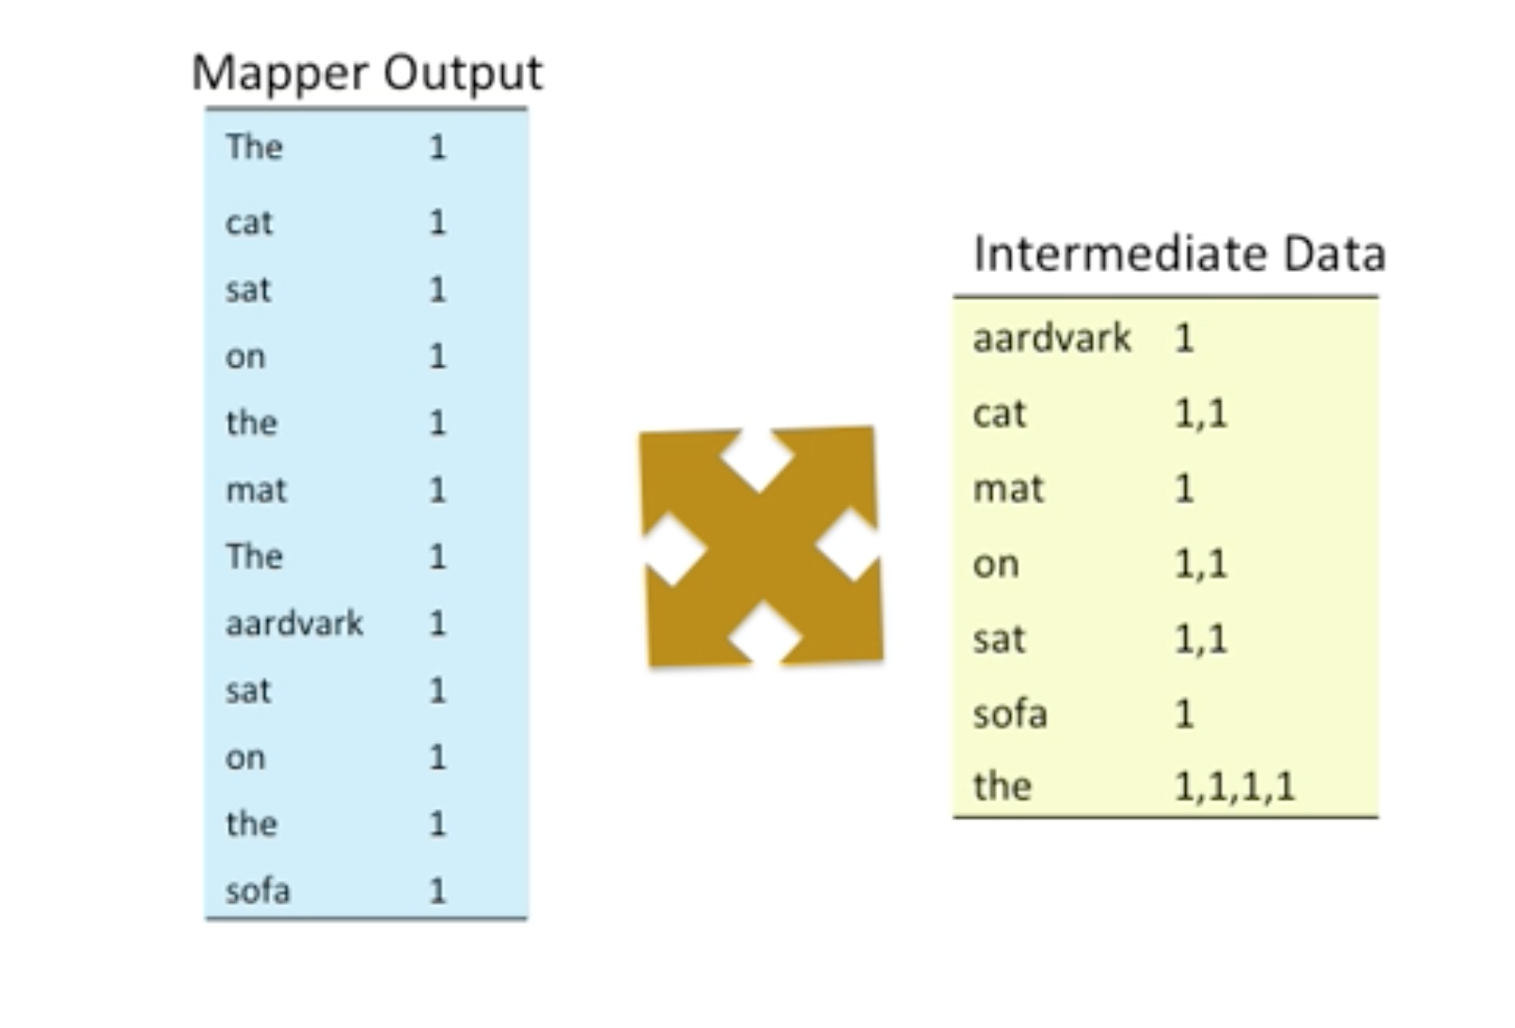
Map Reduce: Word Count [2]
Image source: http://www.cloudera.com/content/cloudera/en/resources/library/training/dissecting-the-apache-hadoop-stack-2-of-6.html, accessed 2014/10/14

Slide 16
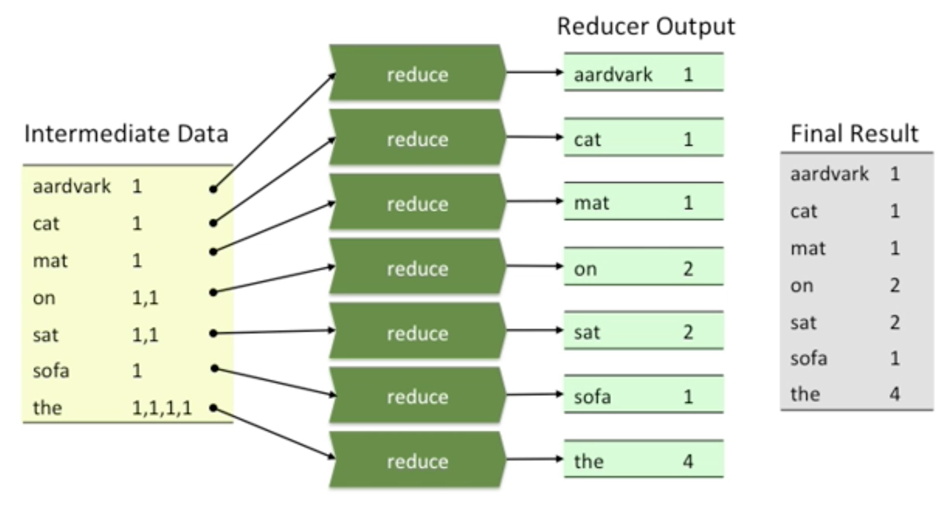
Map Reduce: Word Count [3]
Image source: http://www.cloudera.com/content/cloudera/en/resources/library/training/dissecting-the-apache-hadoop-stack-2-of-6.html, accessed 2014/10/14

Slide 17
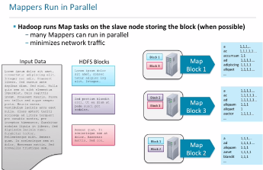
Map Reduce: Word Count [4]
Image source: http://www.cloudera.com/content/cloudera/en/resources/library/training/dissecting-the-apache-hadoop-stack-2-of-6.html, accessed 2014/10/14

Slide 18
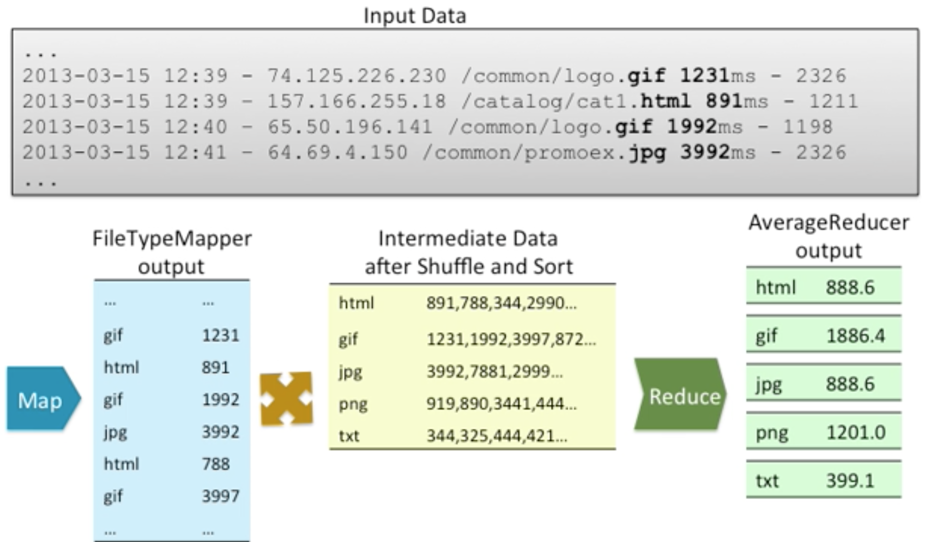
Map Reduce Example: Log Data

Slide 19
Map Reduce Highlights
Processing happens where the data is stored
Parallelization and distribution happens “behind the scenes”
Breaks down complex tasks into smaller elements

Slide 20
Cluster Configuration
Installing a Hadoop Cluster
Different Distributions
Different tools

Slide 21
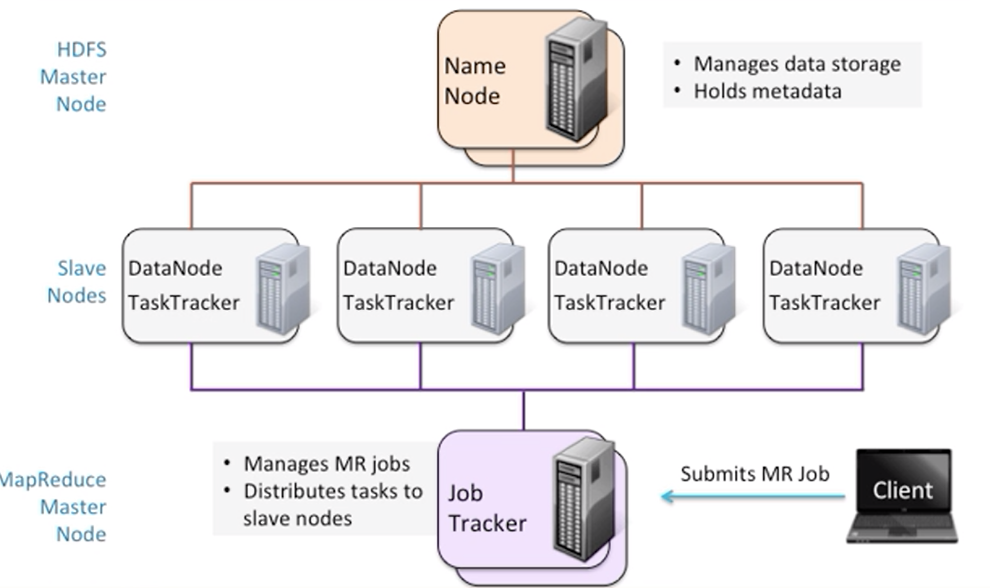
Cluster Layout

Slide 22
Appendix

